Slide 1

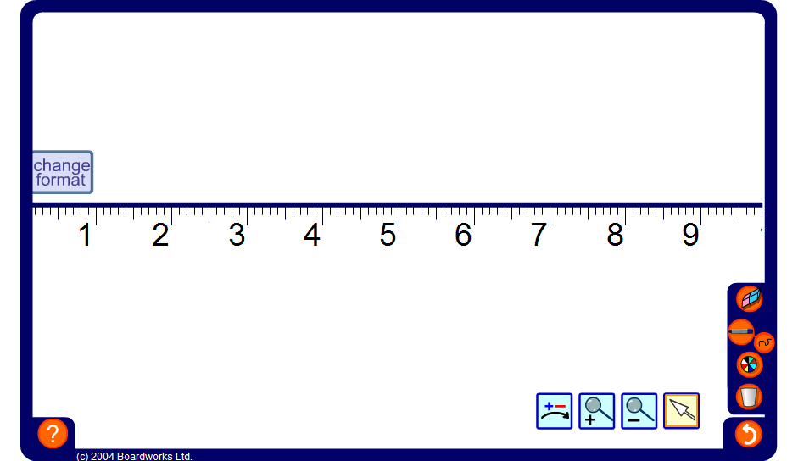


Zooming in on a number line
Notes:
Spend some time zooming in and out of the number line to demonstrate decimals on a number line.
Start by using the zoom in tool to select the area between two whole numbers, for example 1 and 2. Ask pupils to tell you the value of a decimal that would lie between any two given divisions, and zoom in to check.
Establish that by allowing decimals to any number of decimal places, an infinite number of decimals lie between any two given divisions; however many we have found, we can always find at least one more.
Extend the activity by zooming in to show numbers to more decimal places.

